Slide 1


Department of Artificial Intelligence and Data Science
An Enhanced Movie Recommendation Technique Using Cosine Similarity Algorithm
Supervisor
Mr G Thiyagarajan
Assistant Professor
N Gowri Venkat
221801013
Keerthevasan T S
221801026

Slide 2
Problem Statement and Motivation
A streaming service provider aims to improve content recommendation accuracy by analyzing user viewing history and preferences. They aim to increase viewer satisfaction and retention.
Motivation:
1. Enhanced Viewer Satisfaction and Retention .
2. Competitive Advantage
3. Efficient Content Utilization and Acquisition

Slide 3
Objectives
The goal of this project is to improve the streaming service provider’s content recommendation system’s accuracy. By examining the individual’s viewing history and preferences, we hope to present personalized content recommendations that boosts user satisfaction and retention rates.

Slide 4
Abstract
This project aims to enhance the accuracy of a streaming service provider's content recommendation system. By analyzing user viewing history and preferences, it seeks to deliver personalized content suggestions, thereby increasing viewer satisfaction and retention. The project involves data collection, algorithm development, and continuous system refinement to achieve these goals.

Slide 5
Introduction and Overview of the Project.
In this competitive internet world the main aim of every service providing system is user retention. In streaming sector personalization is the main drawback, thus to over come it we have introduced personalized recommendation system this system is achieved by cosine similarity algorithm.

Slide 6
Literature Survey
S.No | Description | Author | Algorithm | Merits | Demerits
1 | This research paper describes a movie recommender system that goes beyond just recommending movies. It also aims to explain why a particular movie is recommended. | Dr. Rangarajan Dr. Sakunthala | Metaheuristics | This approach could be helpful for users who want to understand why a movie is recommended and increase trust in the recommendation system. pen_spark | The paper might discuss limitations of the proposed system, such as computational cost or the accuracy of the explanations provided.
2 | The article describes how to build a movie recommendation model from scratch using unsupervised learning techniques. | Ada Choudhry | Collaborative filtering | The article might discuss the benefits of using machine learning for movie recommendations, such as improved accuracy, personalization, and ability to handle large datasets. | The paper might explore limitations of the proposed system, have a less collections recommendations.
3 | This blog post describes how to build a movie recommendation system using machine learning. It focuses on a collaborative filtering approach | Analytics Vidhya | Collaborative filtering | Collaborative filtering can provide personalized recommendations based on a user's past preferences and the preferences of similar users. | The article may discuss limitations like cold start problems and recommending movies will be difficult for new users. It likely doesn't cover more advanced recommendation techniques.
4 | This research paper likely explores using machine learning algorithms to build a movie recommendation system. | F. Furtado , A, Singh | Latent factors, a type of unsupervised learning | This approach doesn't require labeled data (good or bad ratings) and can identify hidden factors that influence user preferences. | The article doesn't mention potential drawbacks of this method, but some limitations of latent factor models include challenges.

Slide 7
Existing Sytem
User Based Collaborative filtering : The current system employs collaborative filtering algorithm using apache mahout this system uses the dataset collaborates it and produces. The input data is taken in as text and then analysed.
KNN Algorithm: The k-Nearest Neighbors (k-NN) algorithm is used in movie recommendation systems to find the k most similar users (or items) based on their rating vectors and then recommend movies that these similar users have liked or that are similar to those the user has already enjoyed. This approach leverages the similarity between users or items to provide personalized recommendations

Slide 8
Drawback of Existing System
The main drawbacks of the existing system are :
Cannot not handle large dataset
As the input is in form of text the analysis process is complex
This process is time consuming
Less accurate personalization
Cold start problem
Scalability
Sparsity

Slide 9
Proposed System
Our Proposed System Fixes all these issues,
The system will go beyond just purchase history or ratings. It will incorporate user data like preferred genres, cast or crew, and even plot preferences content-based filtering. The suggested moves can be filtered based on language for more structural recommendation .
The first time user are welcomed with a list of top selling and popular movies by selecting one among them we can recommend more of that kind with an attractive user interface.
User feedback on recommendations (likes, dislikes, unexpected favorites) will be used to refine the system's understanding of user preferences and mitigate bias in the data.

Slide 10
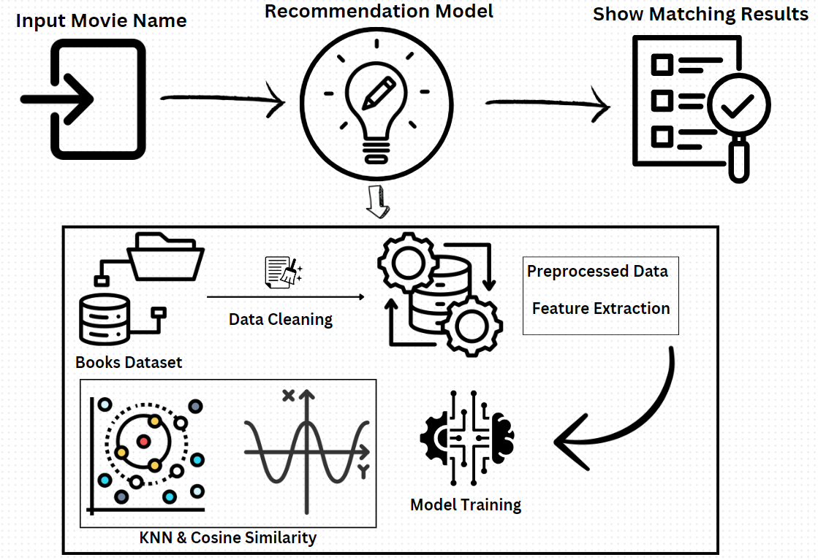
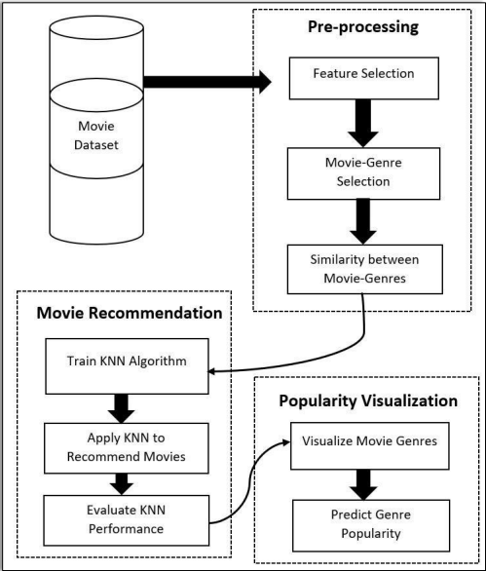
System Architecture and DFD
Movie

Slide 11
List of modules
Module 1 : Data collection
Module 2 : Data Pre processing
Module 3 : Model implementation
Module 4 : Testing Results

Slide 12
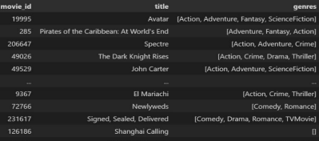
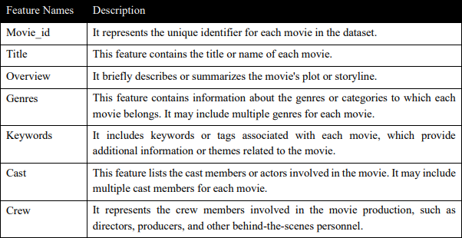
Module 1 : Data collection:
This module involves gathering relevant data for training and testing the recommended movies. The data should include features that are indicative of movie details, and it should be well-labeled to facilitate supervised learning.
The movies details such as title, cast, crew, plot were been collect from The Movie DataBase(TMDB) and IMDB.

Slide 13
Module 2 : Data Preprocessing:
Cleaning includes handling missing values, normalizing or standardizing features, and encoding categorical variables.
Preprocessing helps ensure that the data is suitable for training ml models.
With the help of Natural Language ToolKit (NLTK) to removing stopwords, and making the text more generalize for feature evaluation.

Slide 14
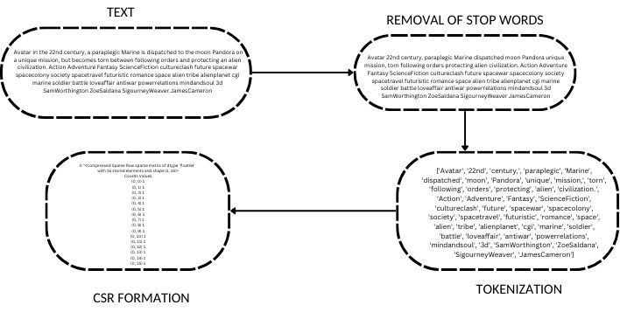
Module 2 : Data Preprocessing:
In the first step we remove stop words from our text
We tokenize the words and form into a array
Then we find the common words and table it
In the final step we turn it into a compressed sparse row for easy clustering

Slide 15
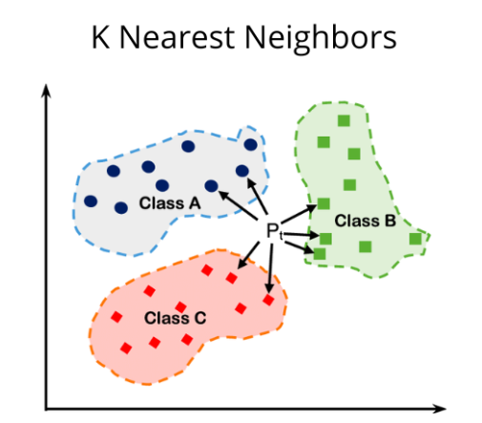
Module 3 : Model Implentation:
I)K-Nearest Neighbour
Movie Feature Matrix: A feature matrix is created, capturing relevant movie attributes like genres, actors, directors, or other characteristics.
K-Means Clustering: The KNN algorithm leverages k-means clustering, which partitions movies into 'k' clusters based on their feature similarities. Each cluster represents a group of thematically related movies.
Recommendation Enhancement: By considering movie clusters, the system can recommend movies from different clusters.

Slide 16
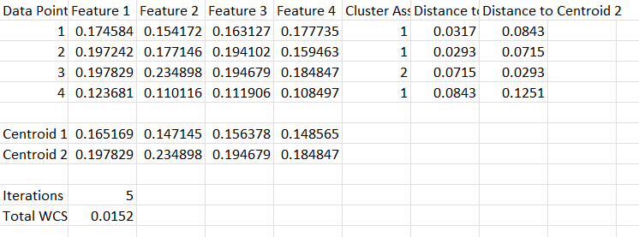
Module 3 : Model Implentation
Data of 4 movies are taken in this example and kmeans clustering is performed with k=2
After 5 iterations the values reach the clustering state where 1,2,4 belong to cluster 1 and 3 belong to cluster 2
This means that 1,2,4 are thematically similar movies and 3 is a movie with different theme .
This process is applied to the whole data set and the all the movies are grouped with thematically similar movies
EXAMPLE OF KMEANS CLUSTERING WITH DATA OF 4 MOVIES

Slide 17
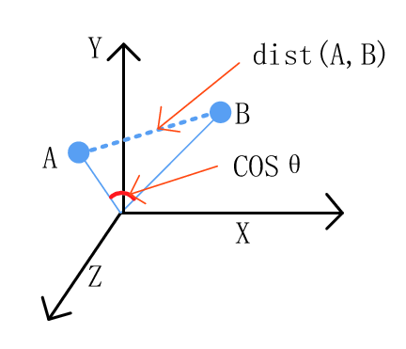
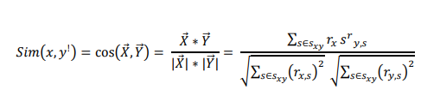
Module 3 : Model Implentation:
II)Cosine Similarity
Cosine similarity is described mathematically as the division between the dot product of vectors and the product of the Euclidean norms or magnitude of each vector.
When plotted on a multi-dimensional space, the cosine similarity captures the orientation (the angle) of the data objects and not the magnitude.
Then employed to compute similarity scores between these movie feature vectors. A smaller angle indicates a higher degree of similarity between the movies.

Slide 18
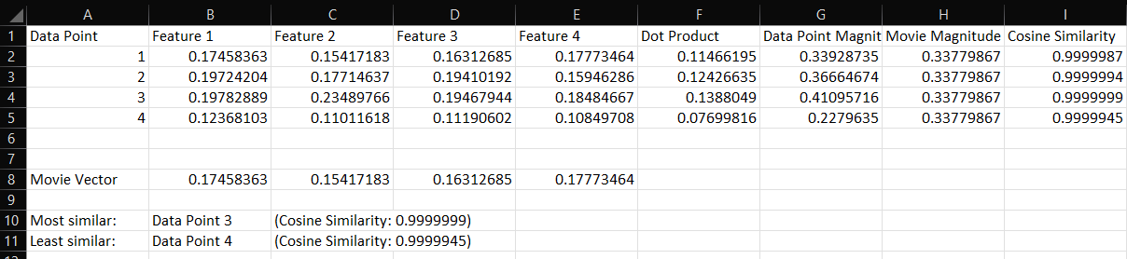
Module 3 : Model Implentation:
We have introduced a new movie vector here and that movies vectors are compared to clusters which are already formed using the kmeans algorithm.
Using cosine similarity algorithm the similarity between that movie and the clusters are found by calculating dot product ,data point magnitude and cosine similarity.
Thus the movie cluster with the closest similarity is shown to the viewer (here cluster 3)

Slide 19
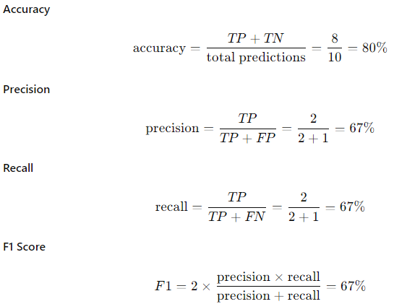
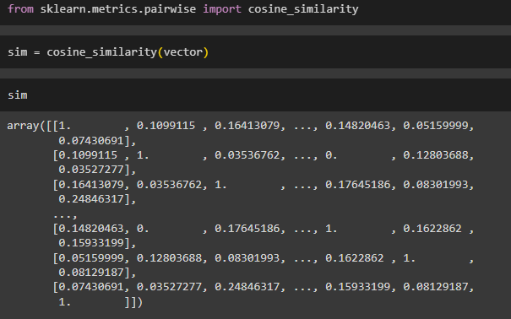
Module 3 : Model Implentation:
Prediction Calculations:

Slide 20
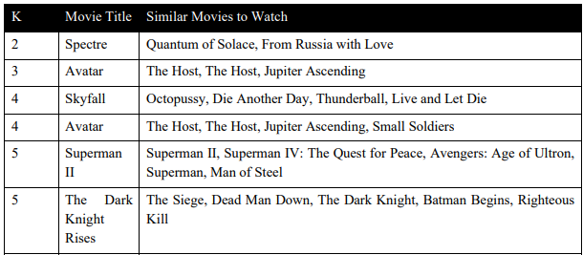
Module Description
Module 4 : Testing & Evaluation:
Once the model has been trained the trained the next step will be to testing to see where it is working properly to improve its accuracy over further testing

Slide 21
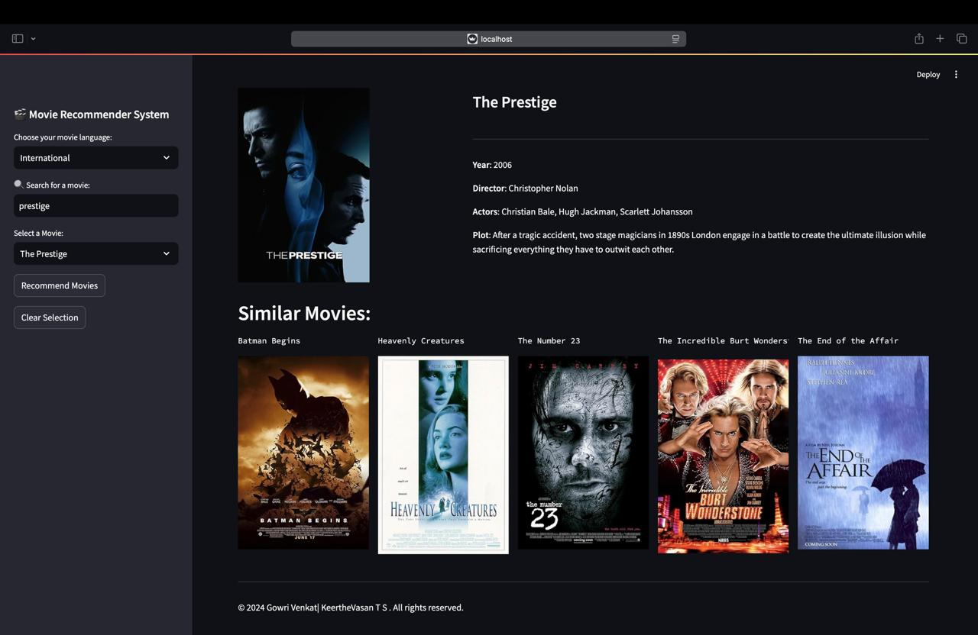
Output :

Slide 22
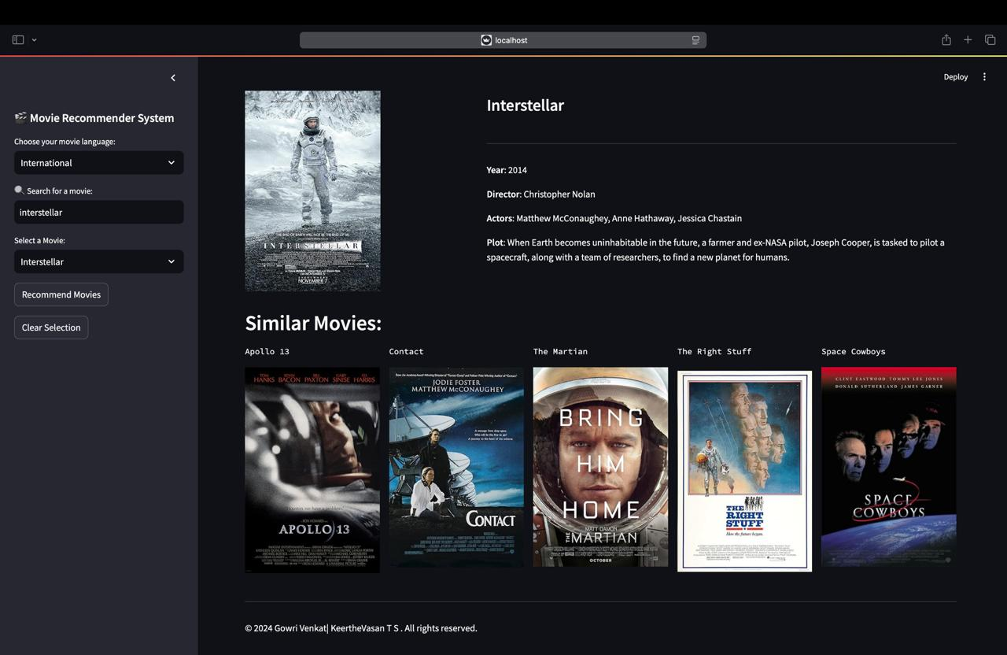

Slide 23
Conclusion:
In conclusion, the KNN movie recommendation model's performance in predicting a user's interest in movies based on their preferred genres is not outstanding, but it is still promising. This Movie recommendation system excels in delivering multiple user benefits through advanced content-based filtering algorithms. It provides highly accurate and personalized movie suggestions, ensuring a high accuracy rate. The user-friendly interface enhances the overall experience by making navigation seamless and enjoyable. This precision in recommendations significantly boosts user satisfaction and engagement. The system consistently delivers reliable recommendations, improving the overall user experience.

Slide 24
References.
https://www.ncbi.nlm.nih.gov/pmc/articles/PMC9269752/.
https://medium.com/@adachoudhry26/getting-started-with-ai-building-a-movie-recommendation-model-from-scratch-c3858d8948b.]
https://www.researchgate.net/publication/347627362_A_review_of_movie_recommendation_system_Limitations_Survey_and_Challenges.
https://www.analyticsvidhya.com/blog/2020/11/create-your-own-movie-movie-recommendation-system/.
https://www.riejournal.com/article_106395_c6c0038f1bf5d4c421bd552d0541d6be.pdf.

Slide 25
Thank You

